Slide 1
76th Geological Congress of Turkey with international participation, April 15-19, 2024, Ankara. Aral Okay Regional Geology and Tectonics Session
YUKARI KELKİT ÇAYI-AGVANİS VE MUNZUR DAĞLARI ARASININ TEMEL JEOLOJİ ÖZELLİKLERİ VE YAPISAL EVRİMİ
MAIN GEOLOGICAL CHARACTERISTICS AND STRUCTURAL EVOLUTION OF THE REGION BETWEEN THE UPPER KELKIT CREEK-AGVANIS AND THE MUNZUR MOUNTAINS
Ali YILMAZ (1), Hüseyin YILMAZ (2)
E-posta: (1) ylmazali06@gmail.com
(WEB: www.profdraliyilmaz.com)

Slide 2
INTRODUCTION- STUDY AREA
TECTONIC UNITS OF THE REGION
Kelkit Relatively Autochthon,
Çimen Dağı Nappe,
Erzincan Nappe
Munzur Limestone
TECTONIC RELATIONSHIPS IN THE REGION
offset of the NAF
STRUCTURAL EVOLUTION OF THE REGION
CONCLUSIONS

Slide 3
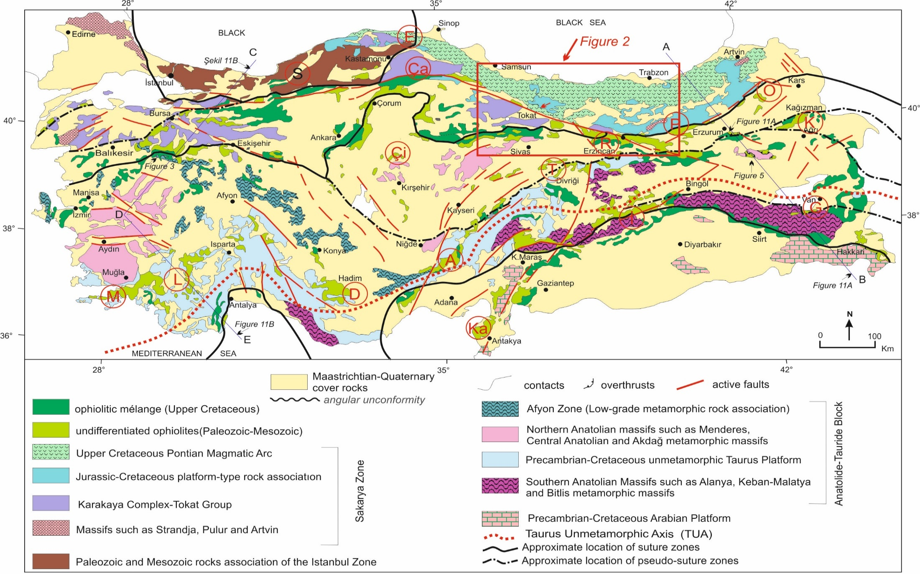
INTRODUCTION- STUDY AREA
(Yılmaz and Yılmaz, 2013; Türkiye Jeoloji Bülteni, 56, 2, 61-114.

Slide 4
Pioneering geological studies and evaluations: Stchepinsky 1940, 1945, Parejas et al.,1942, Ketin, 1951; Baykal, 1952; Nebert, 1951, 1956; then Zankl, 1962; Wedding, 1963; Türkünal, 1971; Irlitz, 1972; Kurtman, 1973; Pelin, 1973; 1977; Tatar 1974; 1977; Gökçen, 1974; Özsayar, 1974; Seymen, 1975; Ataman et al., 1975; Arpat and Şaroğlu, 1975; Bergougnan, 1975 a ve b; 1976 a ve b; Gedikoğlu, 1976; Pelin, 1977; Tokel, 1977; Baş, 1979; Özgül, 1976, 1981; Bektaş, 1981; Şengör ve Yılmaz, 1981; Buket and Ataman, 1982; Okay, 1983; Yılmaz, 1985; Yılmaz et al, 1985.

Slide 5
TECTONIC UNITS OF THE REGION
Kelkit Paraautochthonous,
Çimen Dağı Nappe,
Erzincan Nappe
Munzur Limestone

Slide 6
Geological Map of the Tectonic Units of the study area
(Yılmaz ve diğerleri, 1981; Yılmaz, 1985; Yılmaz ve diğerleri, 1985).

Slide 7
Geological and tectonic map of the Agvanis Metamorphics and surrounding regions(Okay, 1983).

Slide 8
Synthetic stratigraphic section of the Agvanis Methamorphic rocks (Okay, 1983).

Slide 9
Tektonic Units of the region and relative relationships between the units
(Yılmaz, 1985; Yılmaz ve diğerleri, 1985).

Slide 10
TECTONIC RELATIONSHIPS OF THE UNITS
Cross-section of the study area, approximately in the North-South direction
(Yılmaz, 1985; Yılmaz ve diğerleri, 1985).

Slide 11
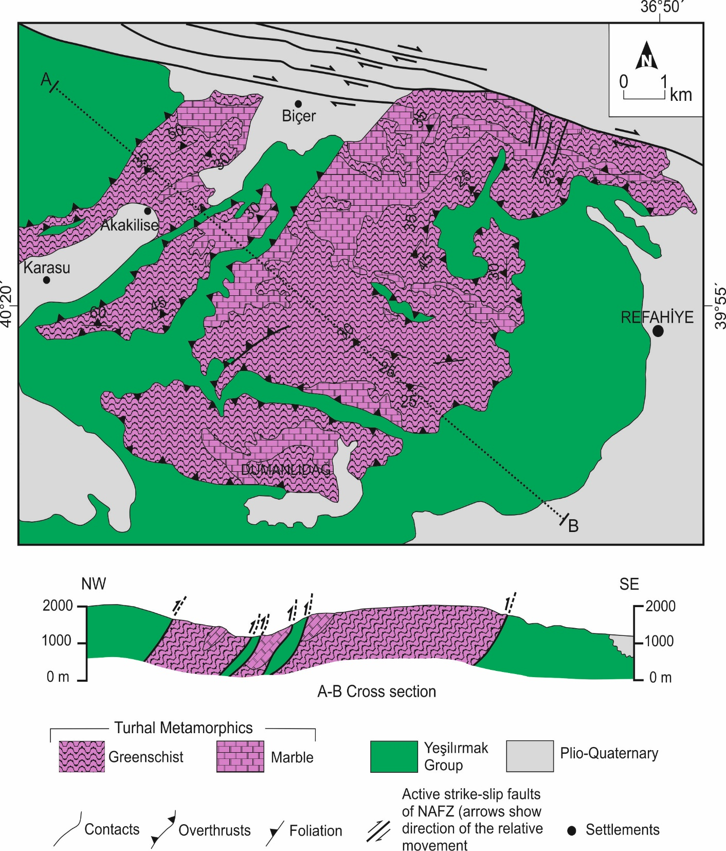

Geological map of Dumanlı Dağ of Refahiye area
(After A. Yılmaz et al. 1985b; Yılmaz ve Yılmaz, 2004’den).
-------------------------------------
Göçmengil et al. (2013)
Topuz et al. (2013)
Yeşilsist, yer yer amfibolit fasiyesi
Early-Middle Jurassic metamorphic accretionary complexes
IAB, E-MORB ortamını temsil etmektedir.

Slide 12
Offset of the NAF
Geological and tectonic map of the study area (After Yılmaz, 1985; Yılmaz and Yılmaz, 2010).

Slide 13
STRUCTURAL EVOLUTION OF THE REGION
Studies questioning the region in terms of tectonic and structural evolution:
Koçyiğit, 1989 (Suşehri Basin: An active fault wedgebasin on the NAF), 1990 (Integrated area of Karakaya, Inner Taurus ve Erzincan sutures), 1996 (Refahiye Superimposed Basin);
Okay, 1989, 1996, 2008; Okay ve Tüysüz, 1999; Okay and Şahintürk, 1997; Yılmaz Y. et al, 1997 a, b; Yılmaz and Yılmaz, 2004, 2006, 2010; Rice et al., 2006, 2009; Sarıfakıoğlu et al., 2009; Gökten, 2007; Topuz et al., 2011, 2013; Göçmengil et al., 2013.

Slide 14
CONCLUSIONS
Current tentative structural evolutionary model of the study area.

Slide 15
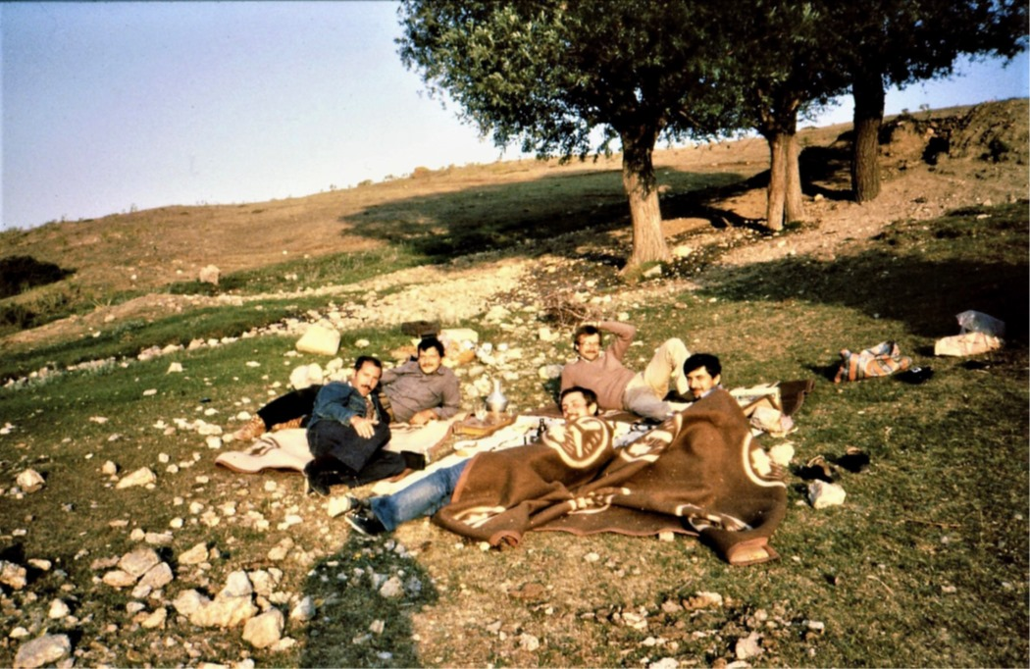
Teşekkürler
VE Gölova (Agvanis)den bir anı
Tayfun Bilgiç’in Arşivinden

